Slide 1
Promoting Ridesharing with Bigdata
Apache Spark + Dataframe + SQL + Tableau
Kening Sun • Minghao Guo • Qiushuang Zhu • Yitong Jin
8/9/2018

Slide 2
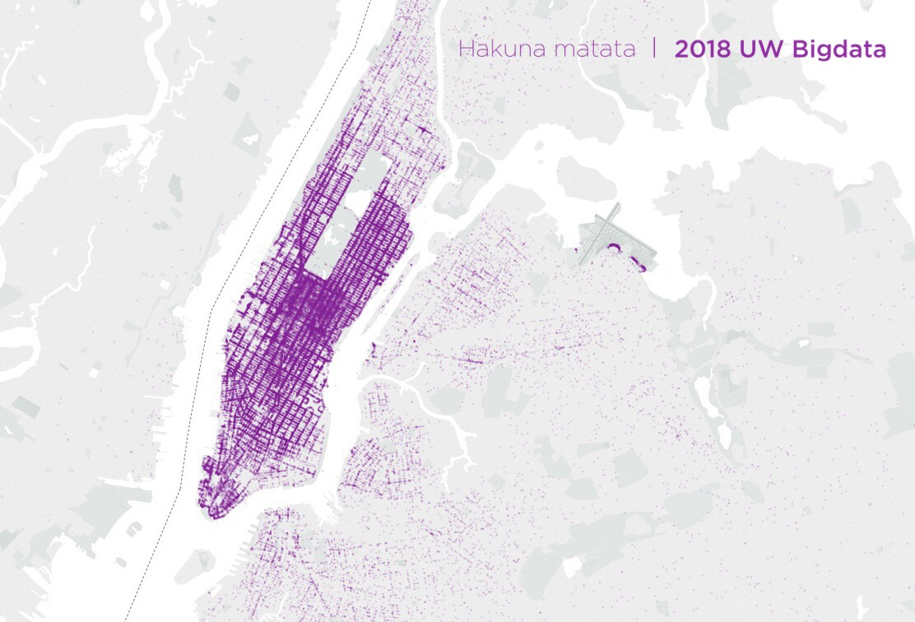
Manhattan, New York

Slide 3
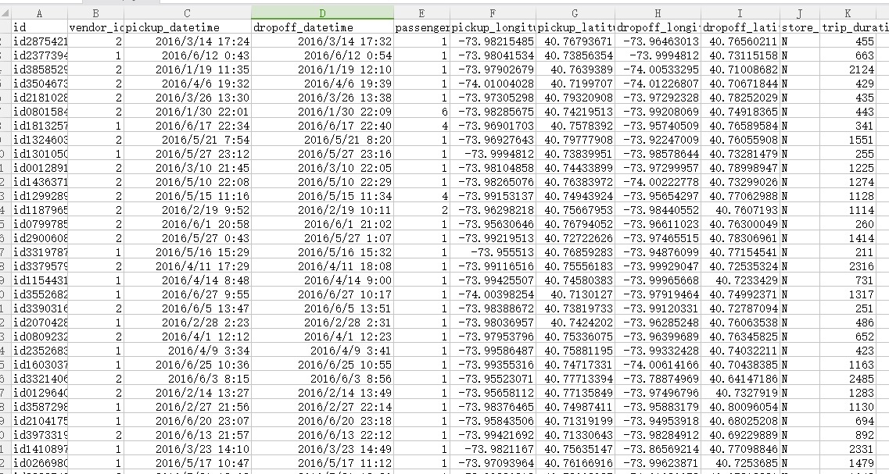
Dataset:
2016 NYC Yellow Cab trip record data

Slide 4
Data Processing Rules:
Dropoff Lat/Lon Accurancy: 0.01°=1113.2m
Pickup Interval: 30min
Pickup Lat/Lon Accurancy: 0.01°=1113.2m

Slide 5
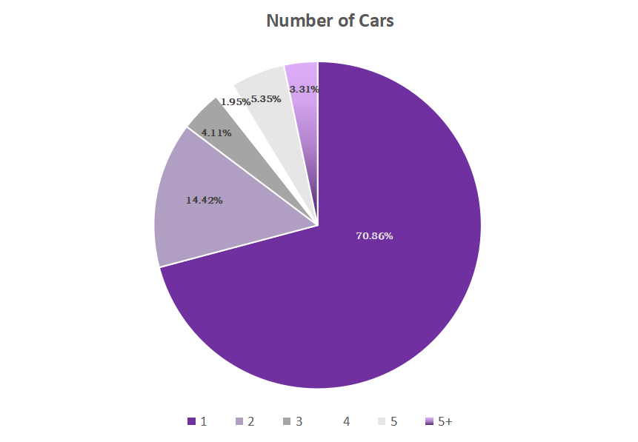
Number of Passengers in One Car

Slide 6
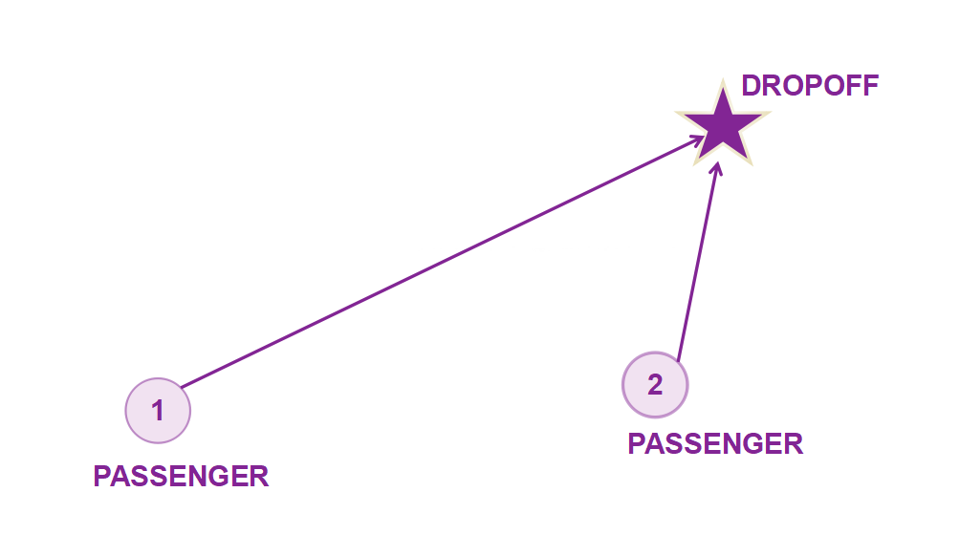
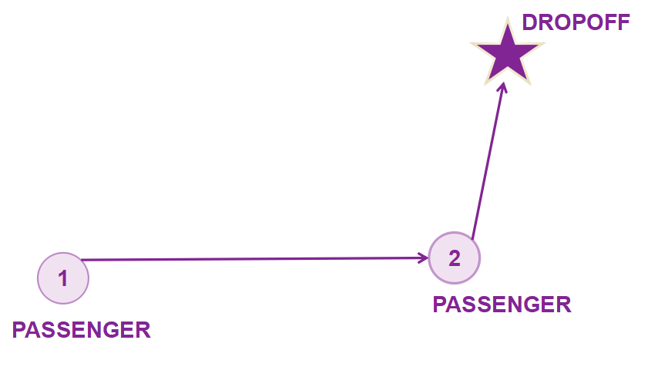
With Ridesharing
Two/Three Vehicles One Vehicle

Slide 7
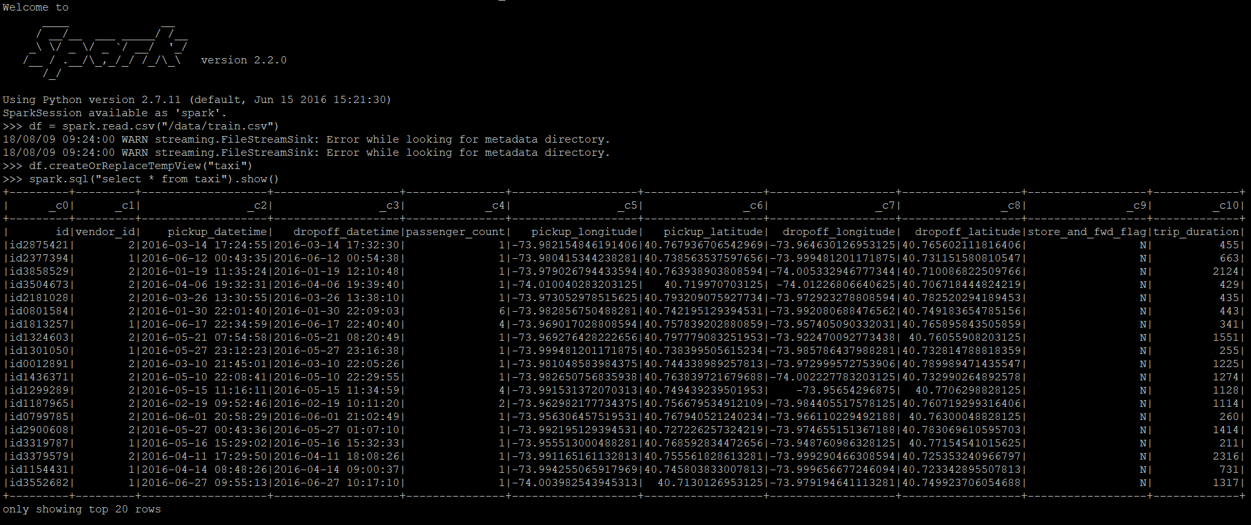
>>>df = spark.read.csv(“/data/train.csv”)
>>>df.createOrReplaceTempView(“taxi”)
>>>spark.sql(“select ' from taxi”).show()

Slide 8
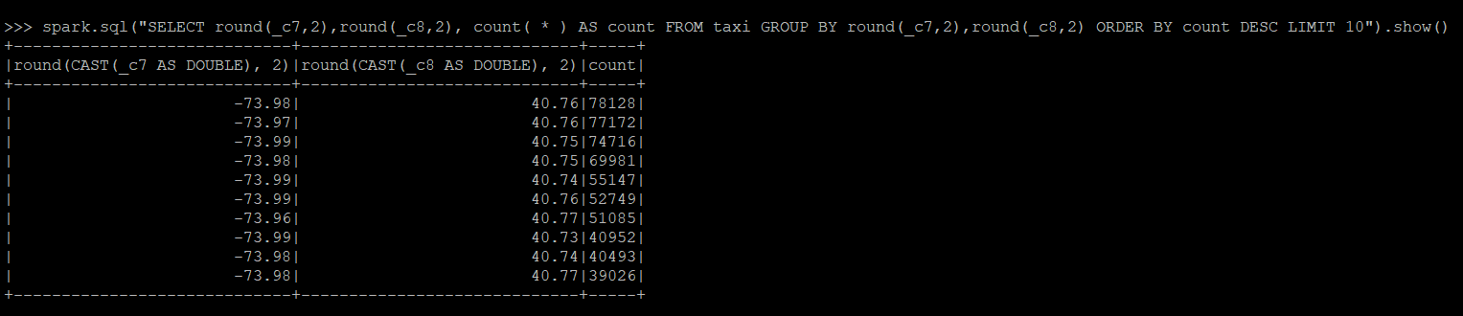
>>> spark.sql("SELECT round(_c7,2),round(_c8,2), count( * ) AS count FROM taxi GROUP BY round(_c7,2),round(_c8,2) ORDER BY count DESC LIMIT 10").show()

Slide 9
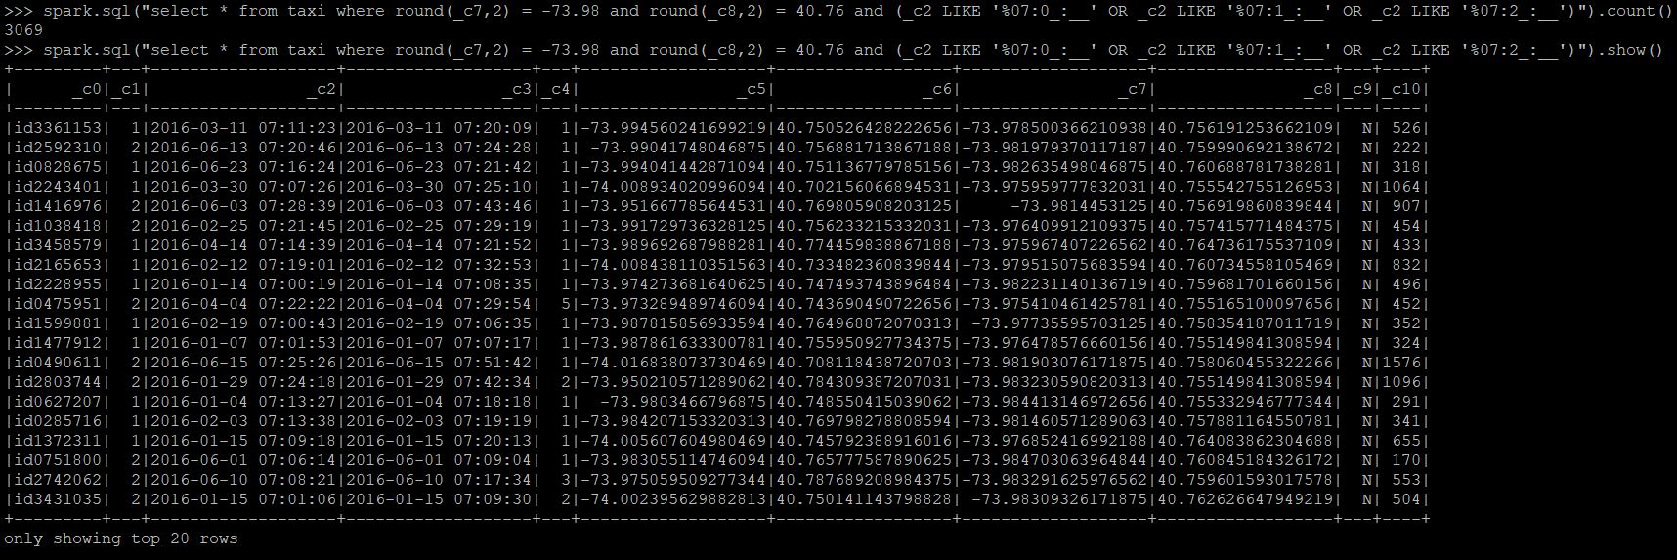
>>> spark.sql("select * from taxi where round(_c7,2) = -73.98 and round(_c8,2) = 40.76 and (_c2 LIKE '%07:0_:__' OR _c2 LIKE '%07:1_:__' OR _c2 LIKE '%07:2_:__')").show()
>>> spark.sql("select * from taxi where round(_c7,2) = -73.98 and round(_c8,2) = 40.76 and (_c2 LIKE '%07:0_:__' OR _c2 LIKE '%07:1_:__' OR _c2 LIKE '%07:2_:__')").count()

Slide 10
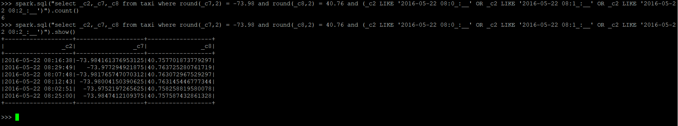
>>> spark.sql("select _c2,_c7,_c8 from taxi where round(_c7,2) = -73.98 and round(_c8,2) = 40.76 and (_c2 LIKE '2016-05-22 08:0_:__' OR _c2 LIKE '2016-05-22 08:1_:__' OR _c2 LIKE '2016-05-22 08:2_:__')").show()
Possible Taxi Ridesharing Records:
Time：8:00 ——8:30
latitude:：-73.97°—— -73.98°
longtitude：40.75° —— 40.76°

Slide 11
According to our analysis, vehicles will decreased 15% in Manhattan with the widely use of ridesharing.
Ridesharing is indispensable in Manhattan

Slide 12
Thanks to Bigdata and
All of You, My Friends
Goodbye

